Slide 1
Temporal Data I (Vis + Pandas) SI370
March 14, 2017 (Pi Day!)
Eytan Adar

Slide 2
Last Time
Dimensionality reduction (MDS)
Visual focus (not necessarily meaningful)
Factor analysis
Principal components analysis (PCA)

Slide 3
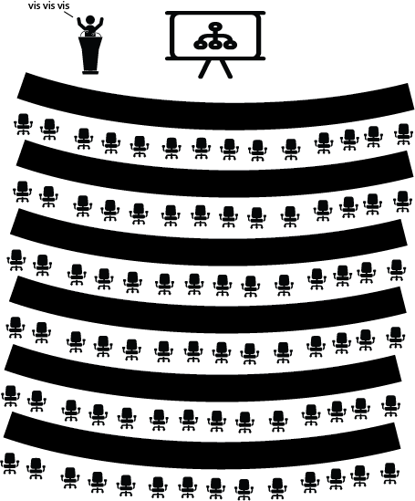
name | PH | Mani’s | Dominos
Alice | 10 | 10 | 10
Jake | 8 | 1 | 10
Sam | 8 | 8 | 5
Beth | 6 | 4 | 6
Ryan | 4 | 5 | 7
Eric | 2 | 6 | 10
Pat | 1 | 10 | 2
10
How much do you like Mani’s dimension
Now what? We’re out of dimensions
0
0
How much do you like Pizza House dimension

Slide 4
name | PH | Mani’s | Dominos
Alice | 10 | 10 | 10
Jake | 8 | 1 | 10
Sam | 8 | 8 | 5
Beth | 6 | 4 | 6
Ryan | 4 | 5 | 7
Eric | 2 | 6 | 10
Pat | 1 | 10 | 2
name | x | y
Alice | -3.5 | 5.59
Jake | 5.18 | 3.9
Sam | -3.2 | .8
Beth | 1.2 | .72
Ryan | 1.2 | -1.33
Eric | 3.55 | -3.33
Pat | -4.52 | -6.42
MDS

Slide 5
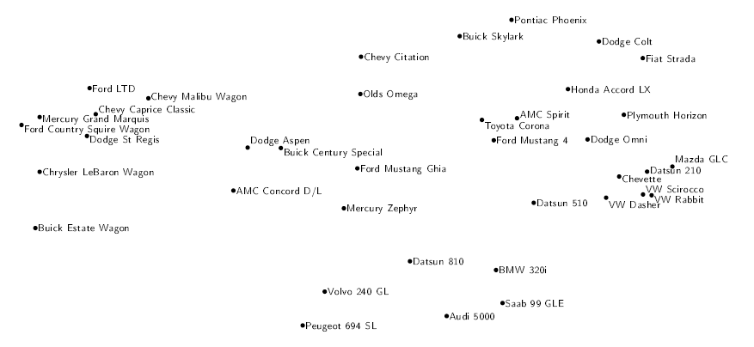
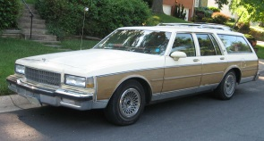
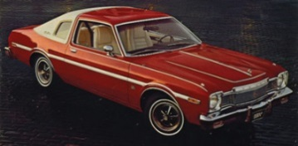
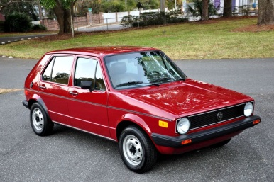
Car Example
Basalaj, http://www.pavis.org/essay/pavis.pdf

Slide 6

We might be able to describe an athlete's abilities in terms of a smaller number of factors that strongly influence their scores in all events.
What are three possible factors
you could hypothesize?
Athlete
Factors are hidden variables we don't observe directly but influence observed outcomes
Runningability
Jumping ability
Throwing ability
100m
sprint
200m
run
110m hurdles
Long jump
High jump
Javelin
shotput
Each event score = variable

Slide 7
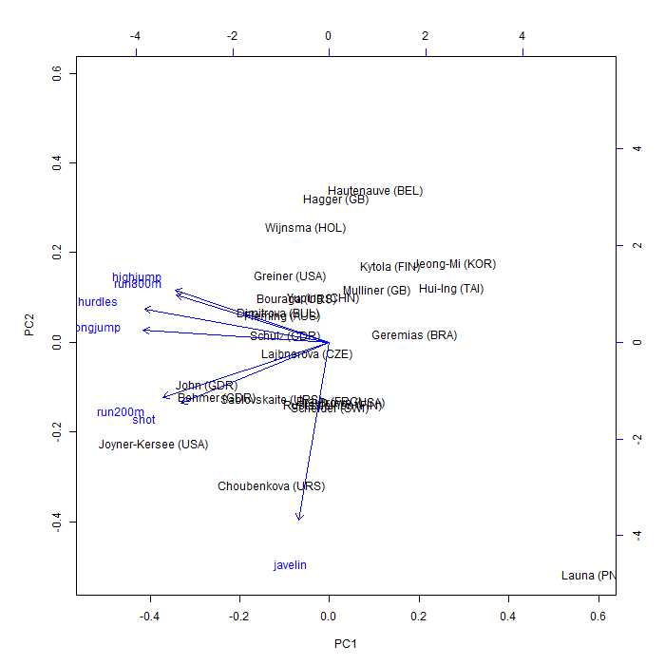
Biplot of heptathlon PCA components
Remember:
For any pair of variables, the angle between their biplot vectors reflects their actual correlation
Athletes good at one event are likely to be good at similar events

Slide 8
Summary
Dimensionality reduction
When we have similarity (or weird spaces)
MDS
When we can assume orthogonal components
PCA

Slide 9
Today: Temporal data
What is temporal data?
How do we visualize it?
Time series
Clustering
Event-driven analysis
Analysis
Cross-correlation
Autocorrelation
Manipulation
Pandas examples

Slide 10
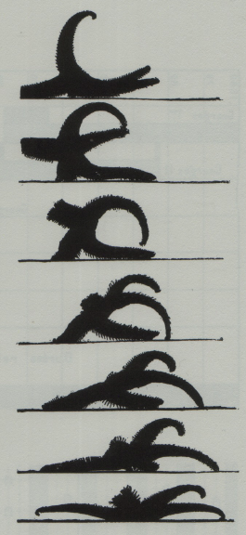
Tufte

Slide 11
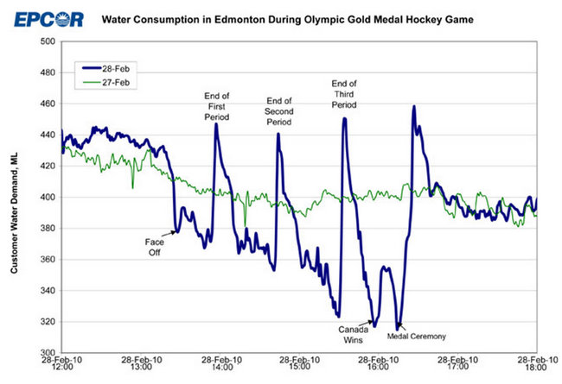
http://www.patspapers.com/blog/item/what_if_everybody_flushed_at_once_Edmonton_water_gold_medal_hockey_game/

Slide 12
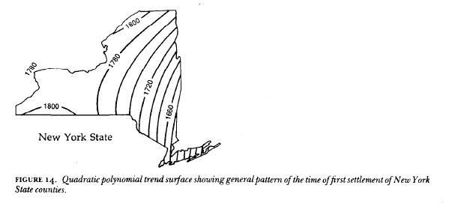
Monmonier, Strategies for the Visualization of Geographic Time Series Data

Slide 13
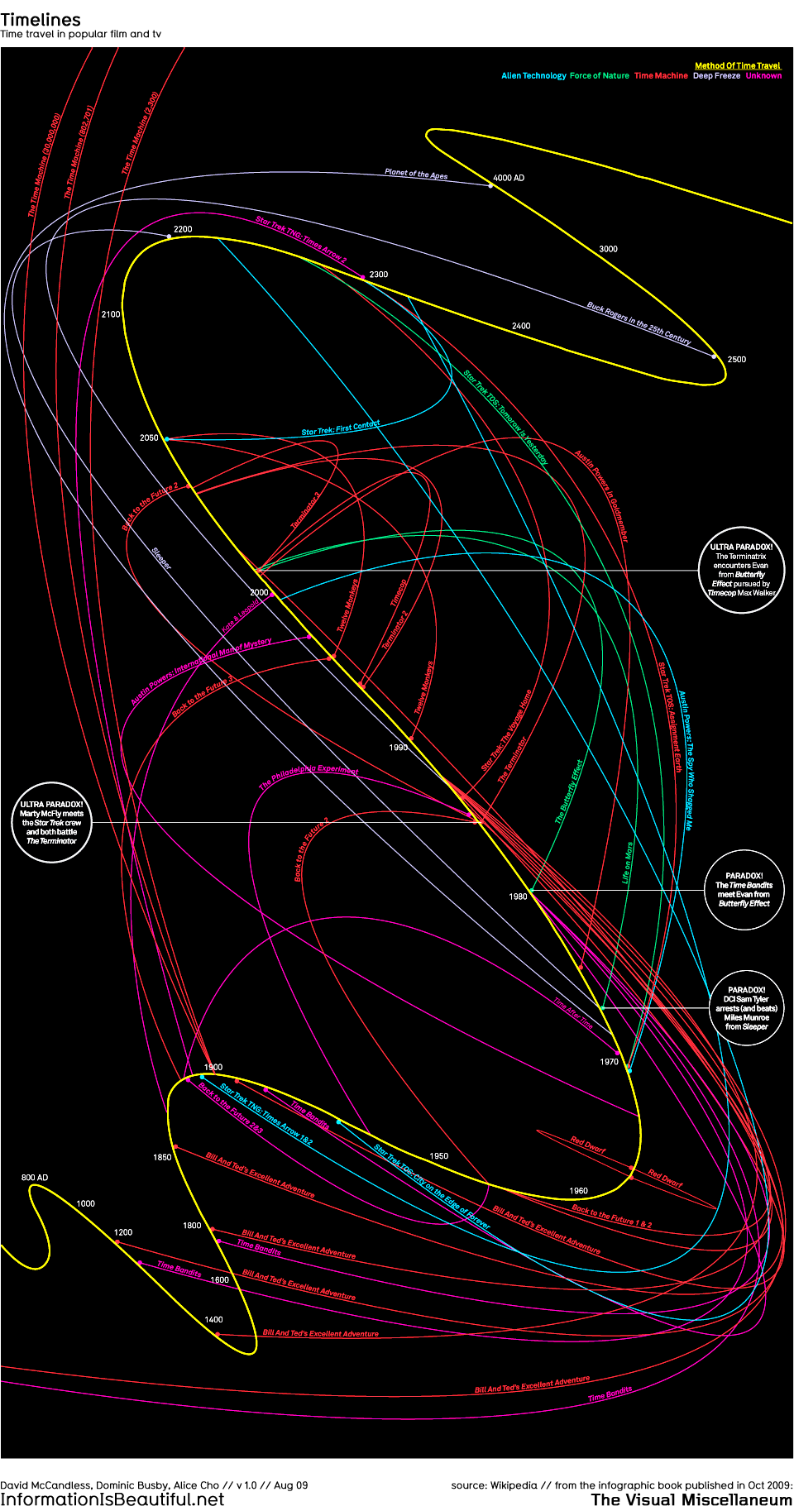
http://www.informationisbeautiful.net/visualizations/timelines/
Notes:
movies

Slide 14
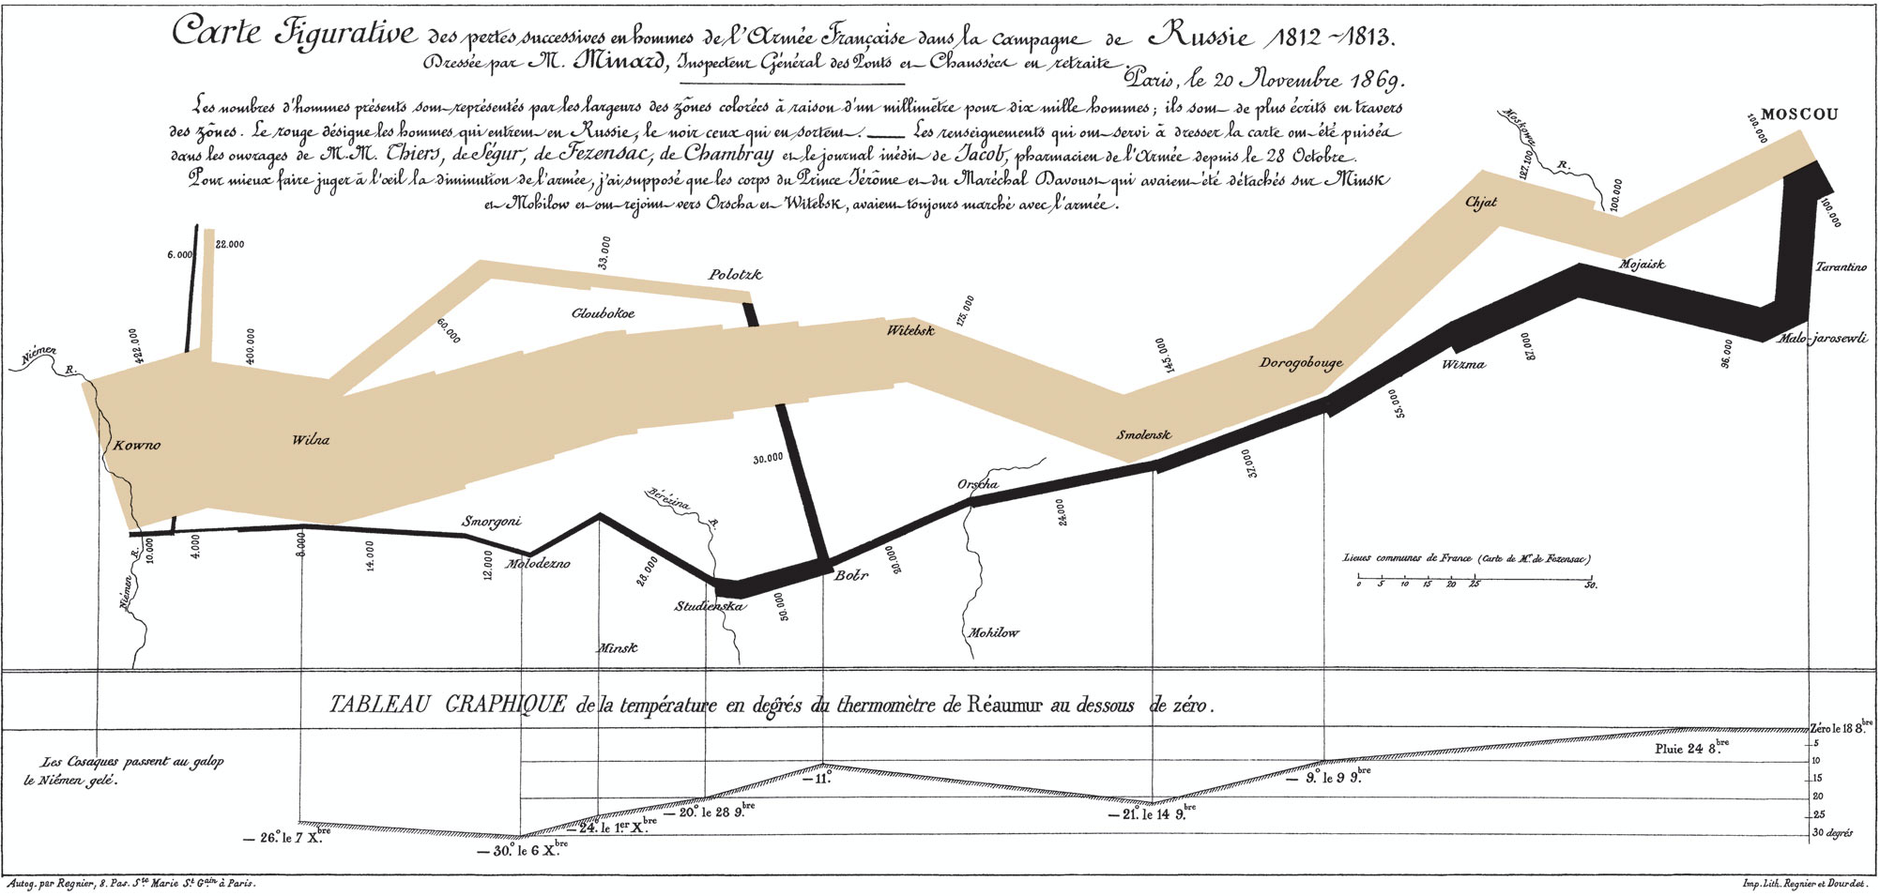
Minard

Slide 15
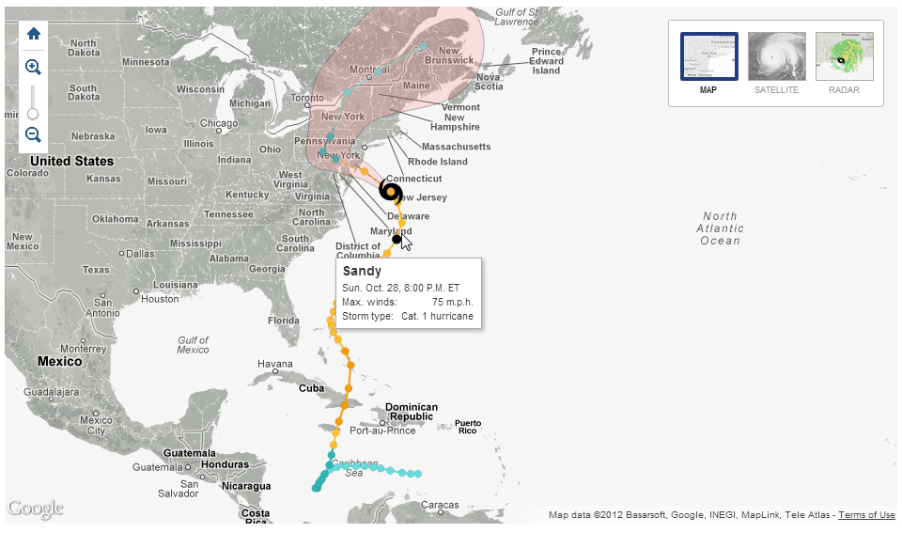
New York Times

Slide 16
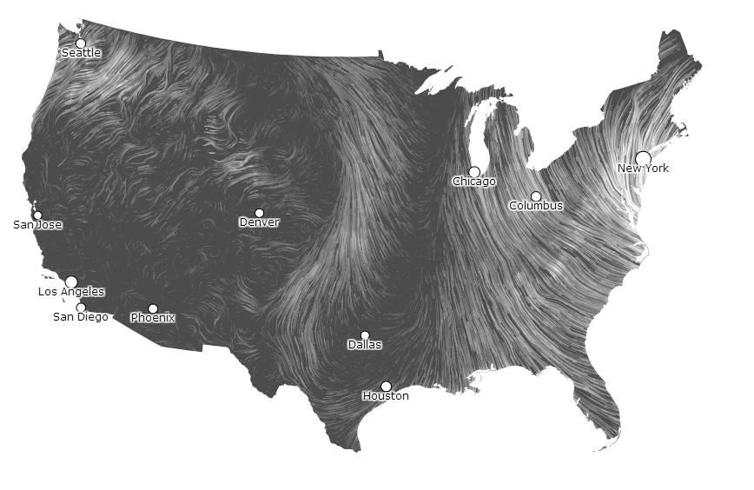
http://hint.fm/wind/

Slide 17
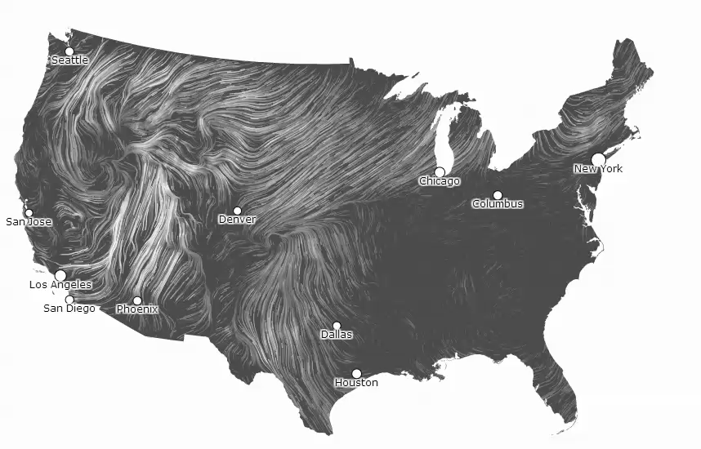

Slide 18
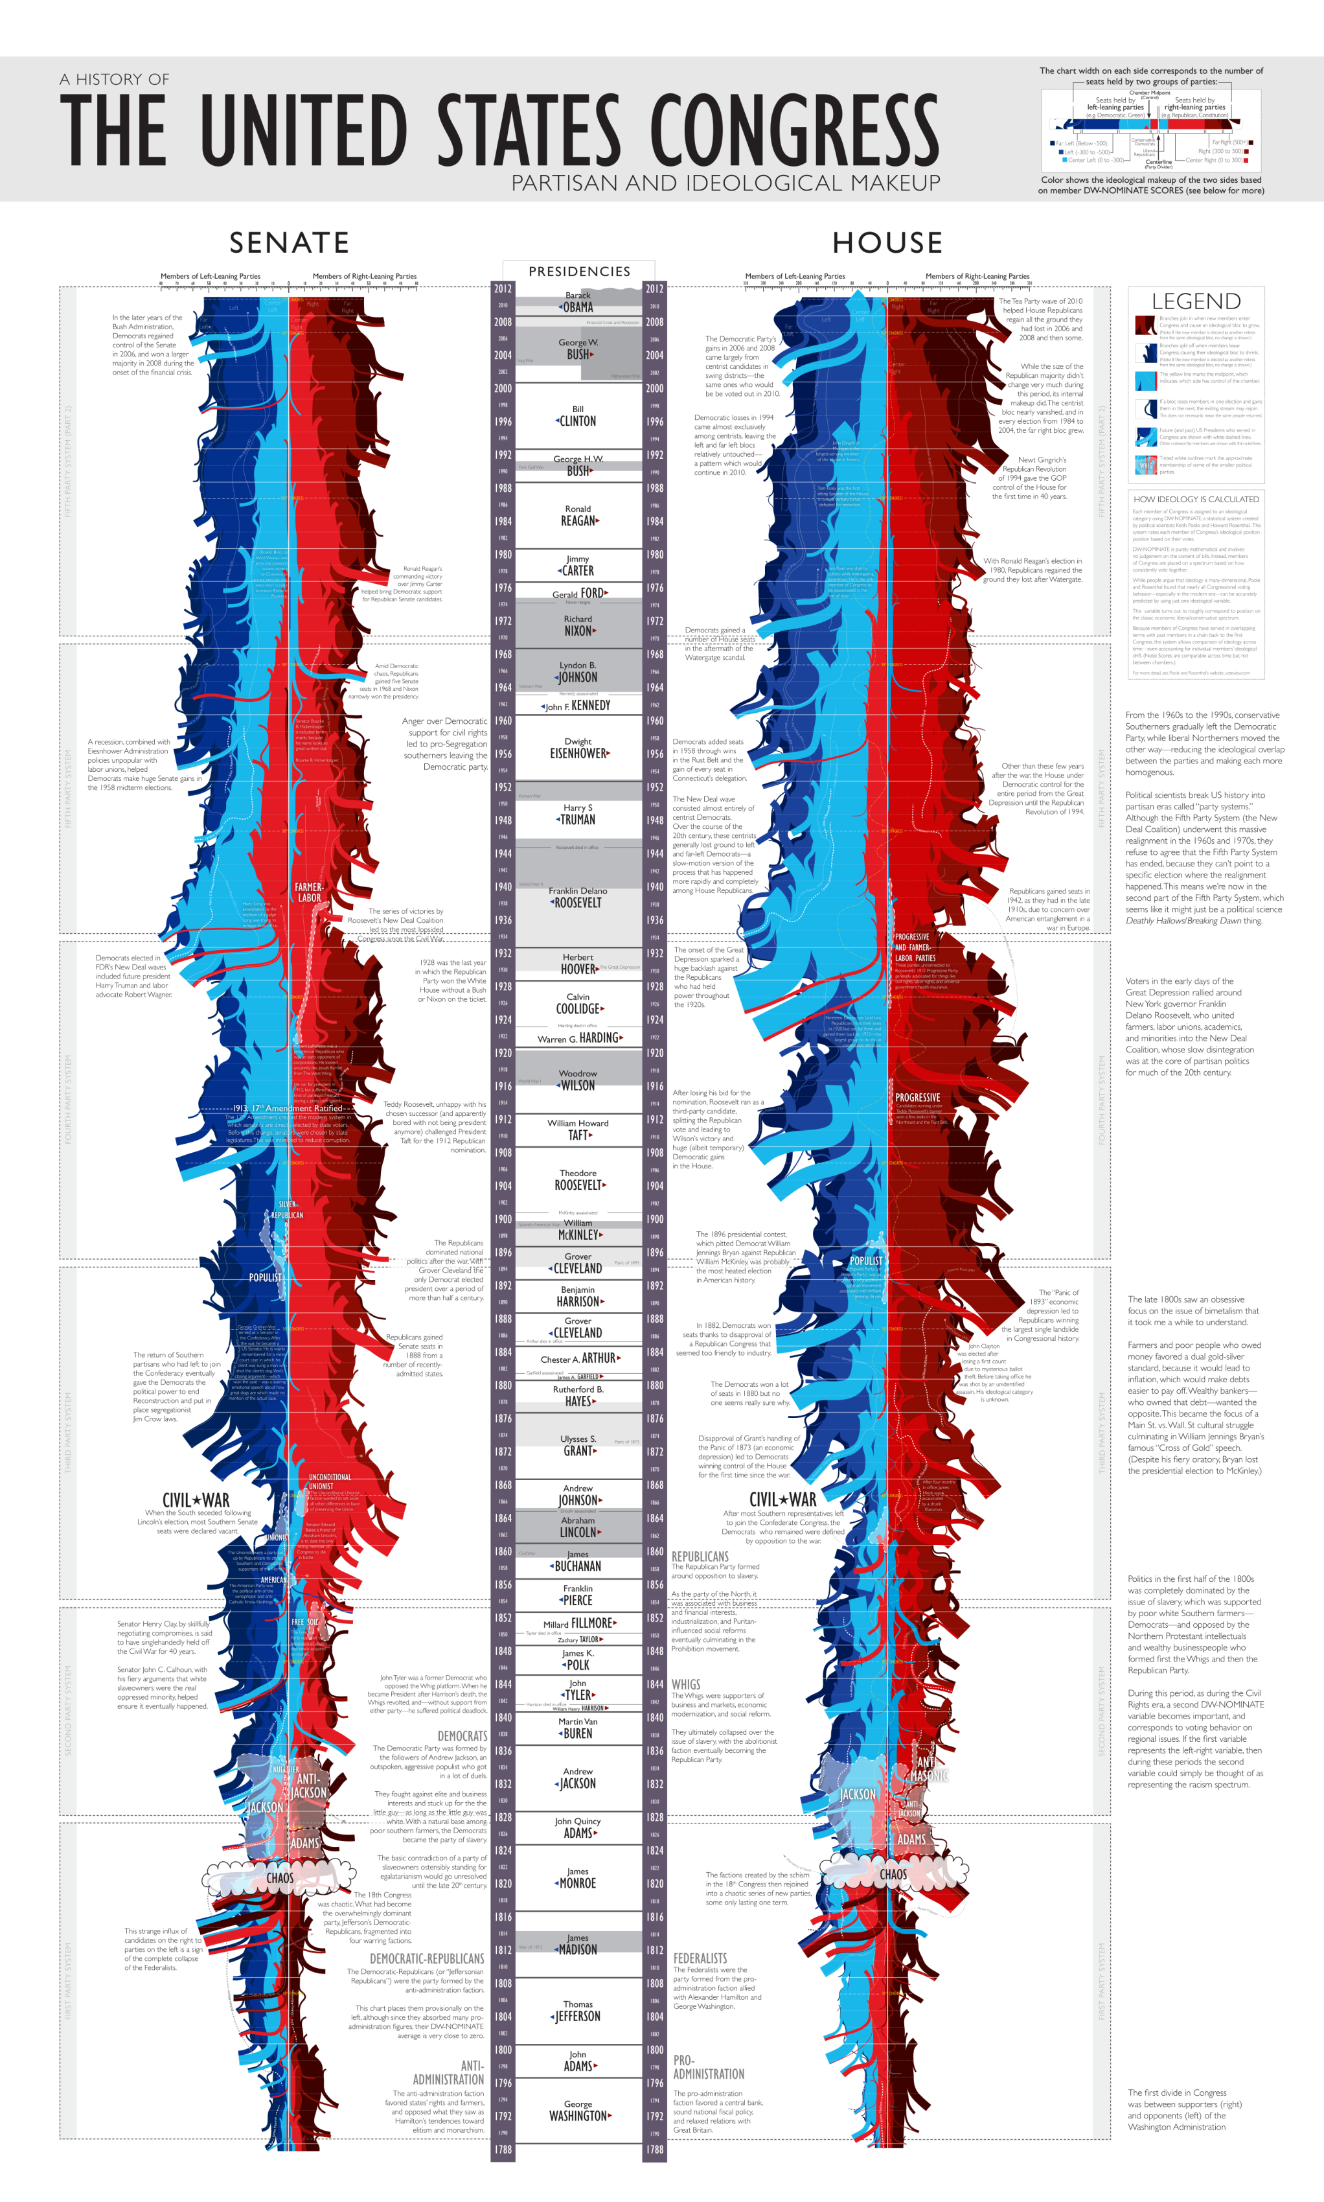

Slide 19
Today: Temporal visualizations (mostly time-series)

Slide 20
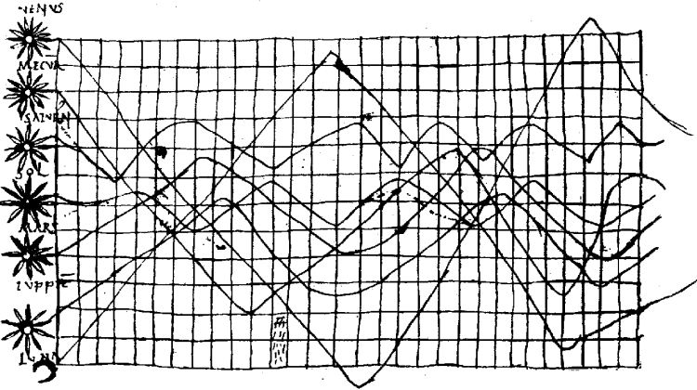
10th century
From Tufte/Funkhouser

Slide 21
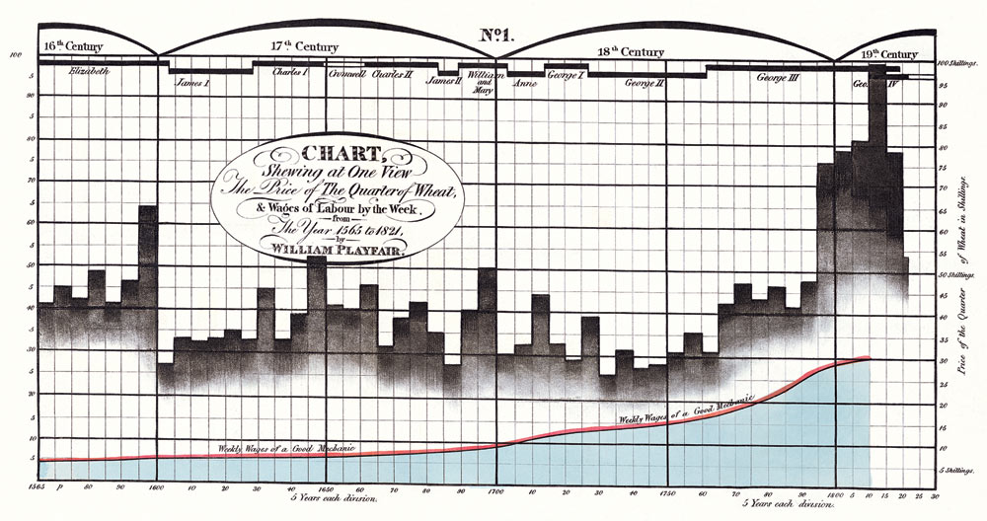
Early 1800s
Playfair

Slide 22
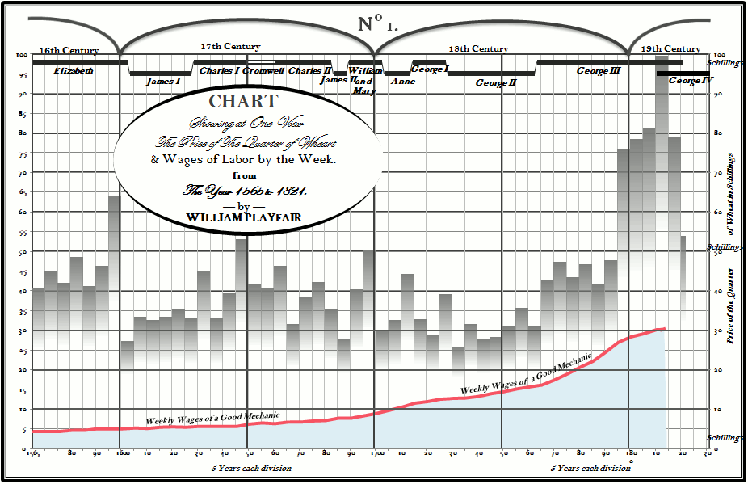
http://www.excelcharts.com

Slide 23
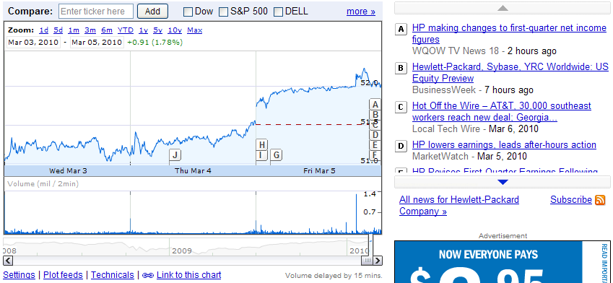
Google Finance, HPQ

Slide 24
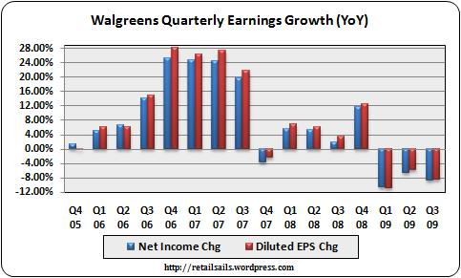

Slide 25
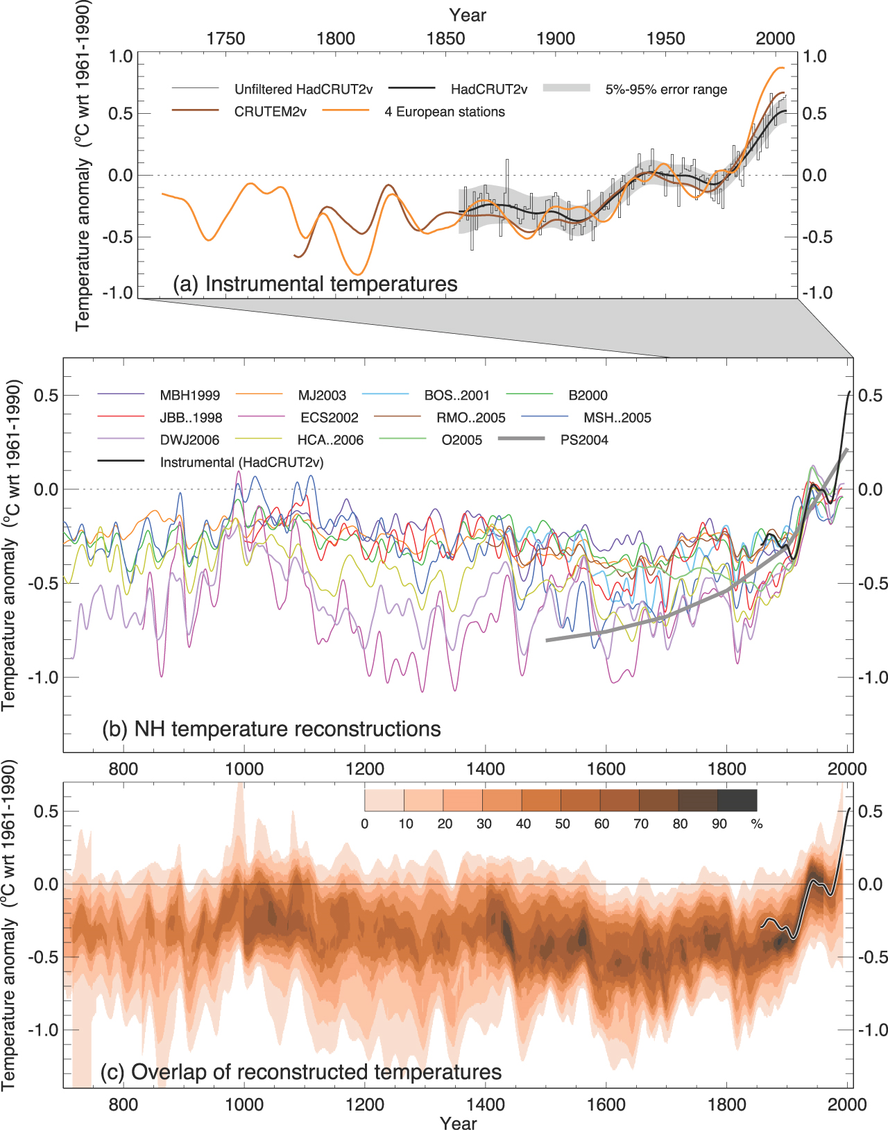
dumbscientist.com/archives/abrupt-climate-change

Slide 26
Canonical (time-series) representation
Quantitative
Value
Time

Slide 27
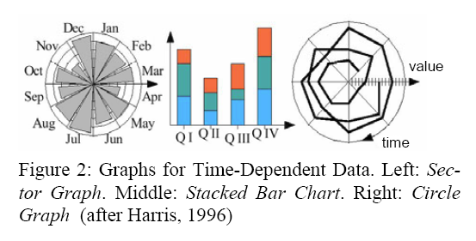
Muller + Schumann, 2003

Slide 28
Some notes on temporal data…

Slide 29
Data Sets (Generally)
Tuples
D = {(t₁,d₁),(t₂,d₂),…(t_{n},d_{n})}
Events – frequent motivator, specific points in time when something “interesting” happens
Ordering – A before B
But…

Slide 30
Temporal data – dichotomies
Discrete time versus interval time
Points in time with no duration, or times with some duration d
d

Slide 31
Temporal data – dichotomies
Discrete time versus interval time
Linear time versus cyclic time
Linear from past to future versus cyclic (morning before evening before morning etc.)
Monday
Tuesday
Wednesday
Thursday
Friday
Saturday
Sunday
1910
2010

Slide 32
Temporal data – dichotomies
Discrete time versus interval time
Linear time versus cyclic time
Ordinal time versus continuous time
Ordinal: before or after, continuous: durations
Ordinal: A happened before B (<, >, = supported)
Continuous: A happened 5 minutes before B (or A and B overlapped for 2 minutes)

Slide 33
Temporal data – dichotomies
Discrete time versus interval time
Linear time versus cyclic time
Ordinal time versus continuous time
Ordered time versus branching time
Single branch with one ordering versus many possibilities

Slide 34
Other Tasks
Does a data element exist at t?
When does a data element exist?
How long does it exist?
How often does it exist?
How fast is the data changing?
In what order do data elements appear?
Do data elements exist together?
Muller & Schumann ’03

Slide 35
Common questions
When was something at min/max?
Is there a pattern?
Two series similar?
Do any of the series match a pattern?

Slide 36
Design Considerations
Static versus Dynamic
“Whole story” view or as-it-happens view
Data versus Event
Data is of interest, or only key events
Conventional versus Multivariate
Time as dominant with a small number of extra variables, or time as part of a big set

Slide 37
Summary so far…
Temporal data is highly ubiquitous
Many different possible tasks
Need to be clear about aim
Determine best data representation
Static versus dynamic
Data versus event
Etc.

Slide 38
Case Studies

Slide 39
Case 1
Many events in the context of a calendar
Tasks
Domain:
See commonly available times for groups
Show detail and broader context
Abstract
Identify common “holes” in event data
Understand events at multiple levels of detail (temporal)

Slide 40
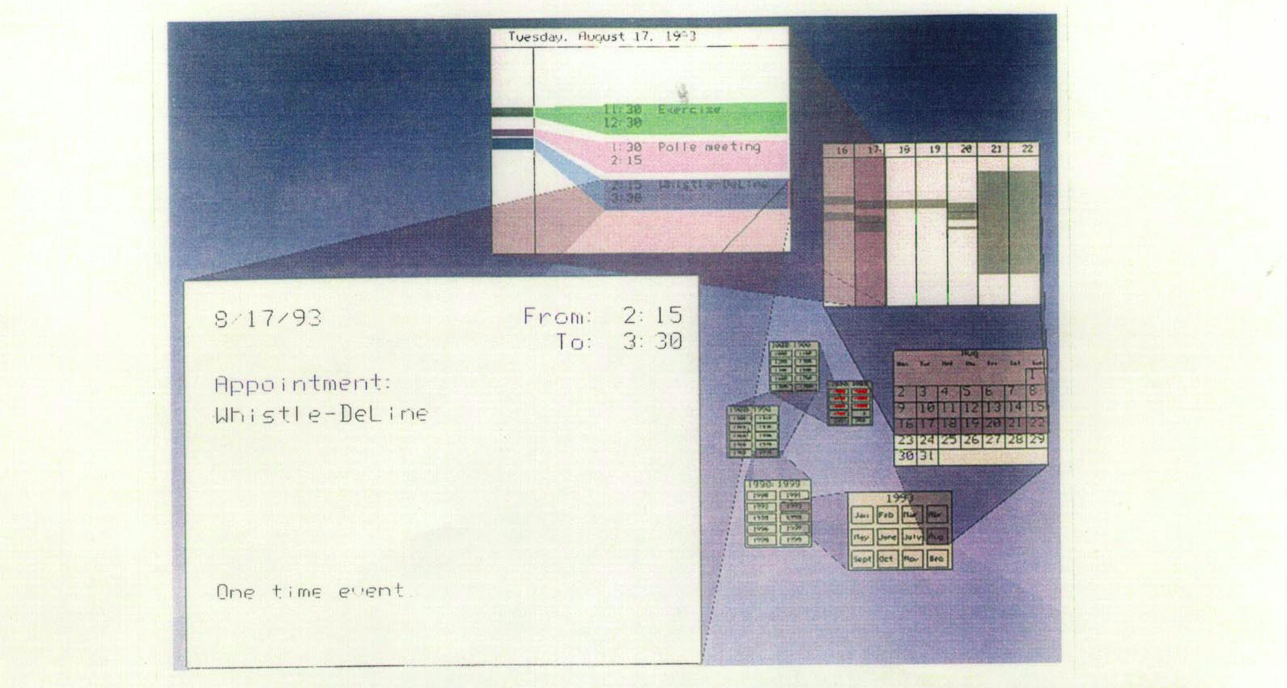
Spiral Calendar
Mackinlay, Robertson & DeLine, UIST’94

Slide 41
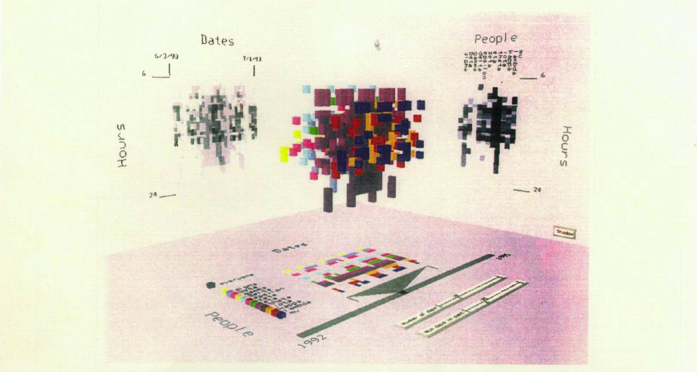
Time Lattice
Mackinlay, Robertson & DeLine, UIST’94

Slide 42
Case 2
Domain
Identify common patterns of worker behavior in a factory
What are key patterns over course of a year?
Factory workers clocking in/out
Abstract
Correlate different time series
Group time series by similarity

Slide 43
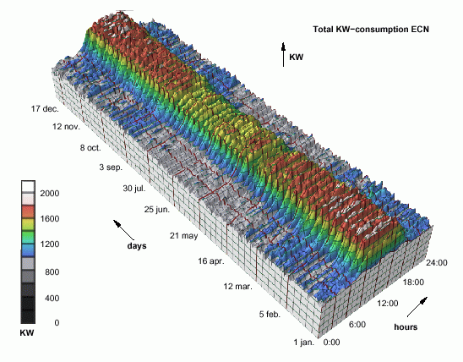

Slide 44
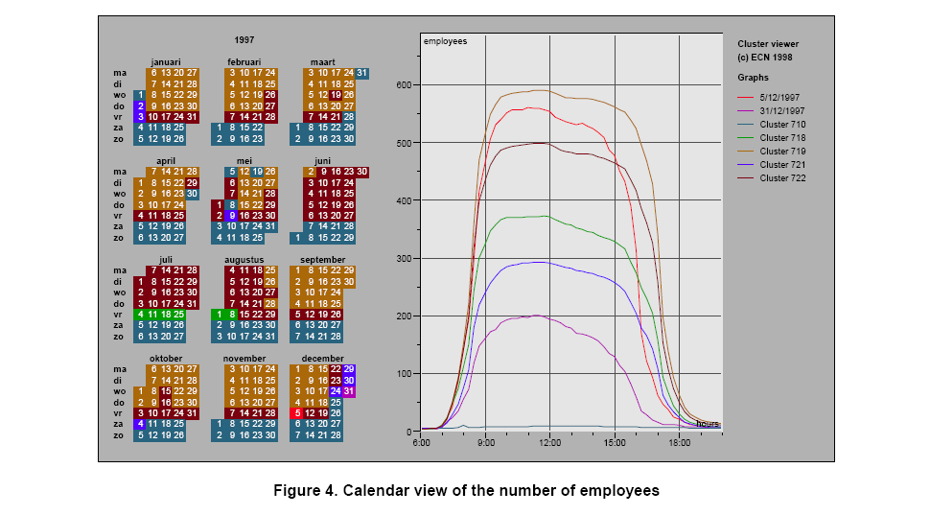
Calendar View, van Wijk et al., 1999

Slide 45
Insights
Traditional office hours followed
Most employees present in late morning
Fewer people are present on summer Fridays
Just a few people work holidays
School vacations occurred May 3-11, Oct 11-19, Dec 21-31
Many people take off day after holiday
Many people leave at 4pm on December 5
Notes:
5th – dutch celebration of santa claus

Slide 46
Case 3
Domain:
Identify how different resources are “produced” or “consumed” over time
Media attention, consumer $’s, etc.
Abstract:
Outliers
Common patterns
Correlations
Relative attention

Slide 47
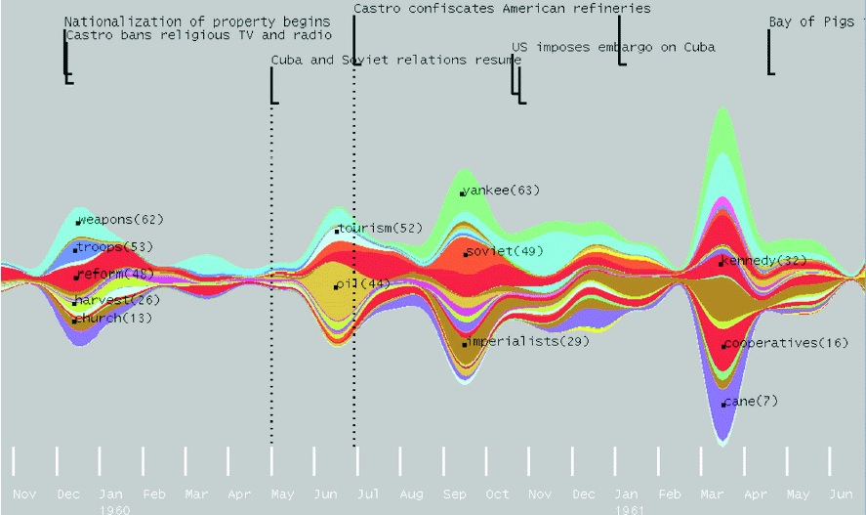
Theme River, Havre et al., 2000

Slide 48
Modern instance
Stacked graph
Steamgraph
Goals:
Show multiple time series
Be able to see sum
Make labels legible
Distinguish layers
Aesthetically pleasing

Slide 49
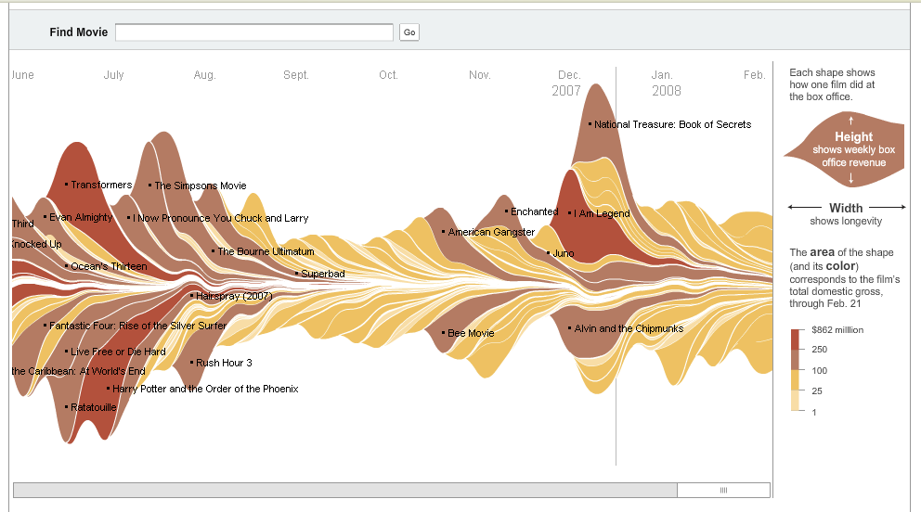
Byron & Wattenberg
http://www.nytimes.com/interactive/2008/02/23/movies/20080223_REVENUE_GRAPHIC.html

Slide 50
Case 3
Byron & Wattenberg
http://www.nytimes.com/interactive/2008/02/23/movies/20080223_REVENUE_GRAPHIC.html

Slide 51
Group question: What perceptual problems might make steamgraphs less effective?

Slide 52
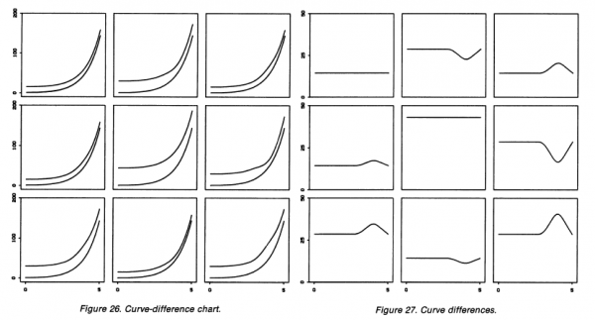
The problem with streamgraphs
Graphical Perception: Theory, Experimentation, and Application to the Development of Graphical Methods", Cleveland and McGill (1984
http://www.visualisingdata.com/index.php/2010/08/making-sense-of-streamgraphs/

Slide 53
Group question: What interactive features might improve these?

Slide 54
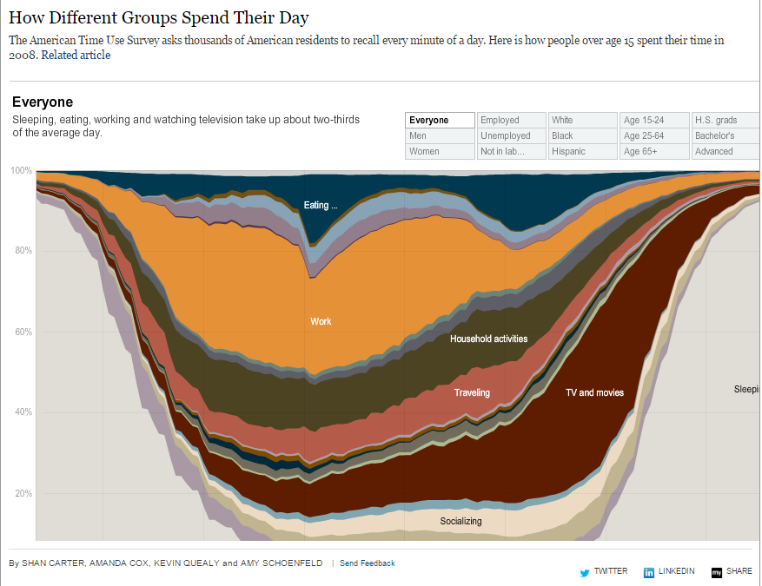
http://www.nytimes.com/interactive/2009/07/31/business/20080801-metrics-graphic.html

Slide 55
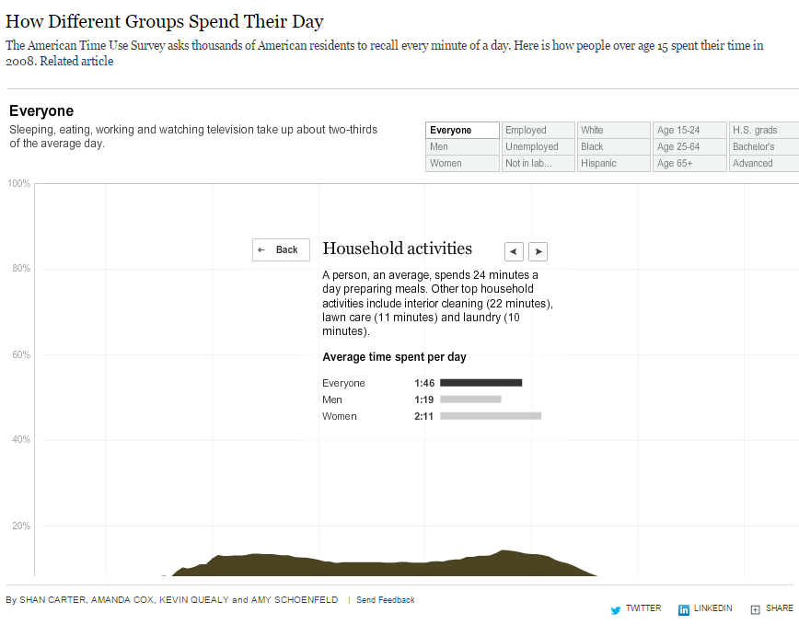
http://www.nytimes.com/interactive/2009/07/31/business/20080801-metrics-graphic.html

Slide 56
Case 4
Personal histories
Chronological series of events (in life)
Examples:
Medical history
Educational background
Criminal history
Basketball gameplay
Group question: What might be common abstract tasks/needs?

Slide 57
Case 4
Personal histories
Chronological series of events in life
Examples:
Medical history
Educational background
Criminal history
Tasks:
Complete story
Information for decision making
Notice trends
Overview to grasp big picture

Slide 58
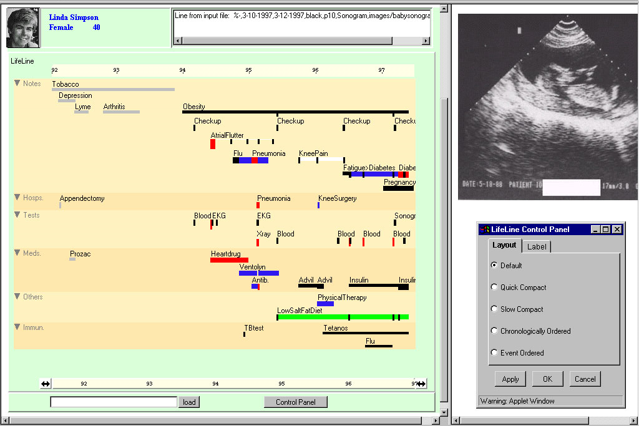
LifeLines, Plaisant et al. (demo at: http://www.cs.umd.edu/hcil/lifelines/latestdemo/chi.html)
Notes:
Put together complete story
Garner information for decision-making
Notice trends
Gain an overview of the events to grasp the big picture

Slide 59
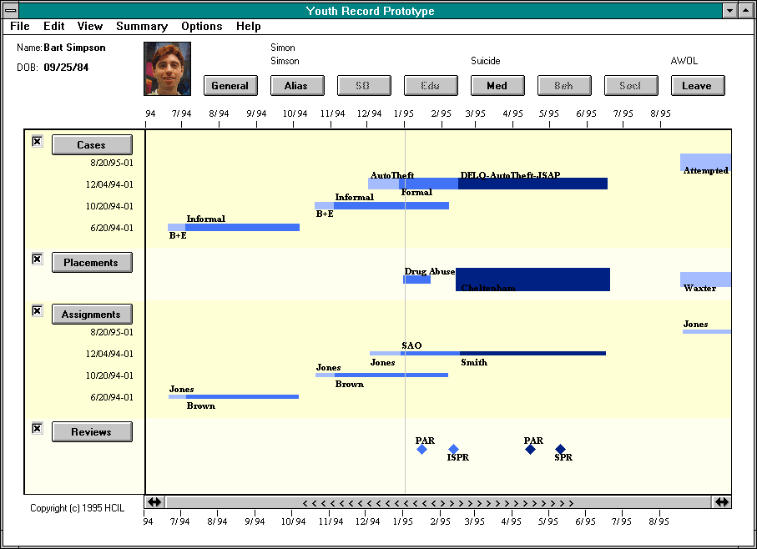

Slide 60
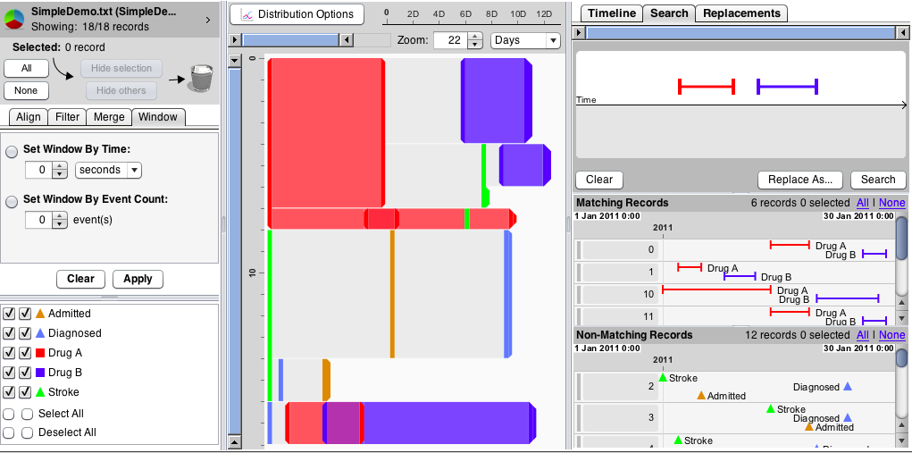

Slide 61
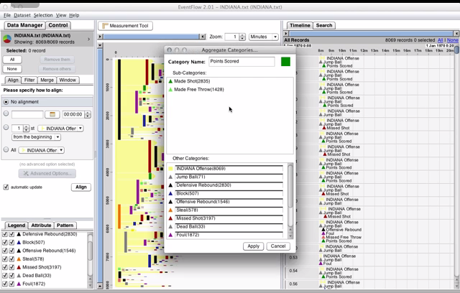

Slide 62
Features + Benefits
Features
Colors for event types
Line thickness can correspond to another variable
Click on event for more details
Benefits
Reduce chance of missing info
Facilitate spotting trends or anomalies
Streamline access to details
Remain simple and tailorable to applications

Slide 63
Case 5
Domain:
Track Wikipedia page evolution
Make anomalies/significant patterns salient
E.g., edit wars
Identify reverts through visualization (specific event type)
Abstract
Track change over time of document (edited by multiple people)
Anomaly detection: Identify key events or event sequences
Singletons (e.g., reverts)
Patterns (e.g., edit wars)

Slide 64
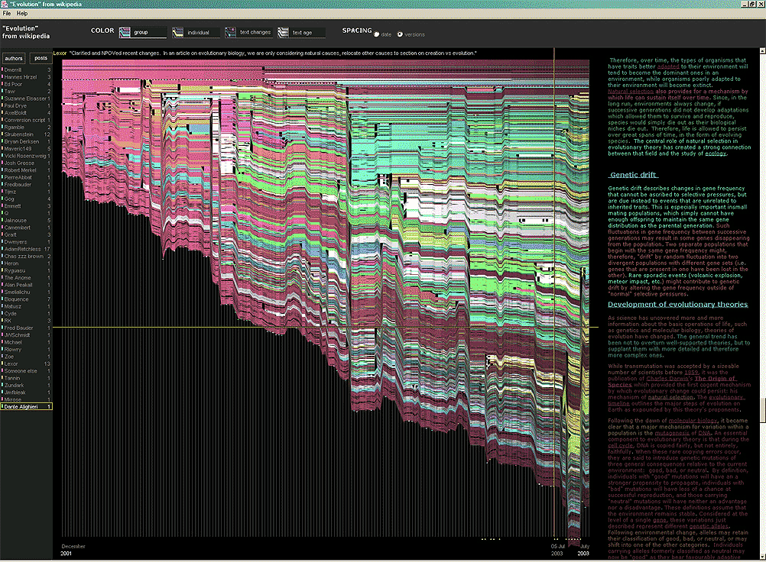
History Flow, Viegas et al.

Slide 65
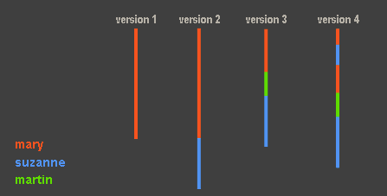
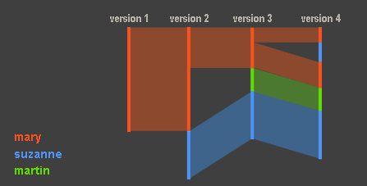

Slide 66
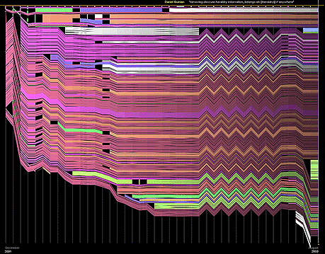
Chocolate page

Slide 67
Case 6
Domain: Music
Correlate sampling/sampled behavior
Entities are songs (sampling and sampled)
Relative times and amounts of sampling behavior
Track sampling behavior of artists
Abstract
Correlate two entity types that have connection (bipartite temporal graph)
Track time of event data
Find connected entities based on secondary features (i.e., album type or artist)
Compare distributions of event data
Identify peaks

Slide 68
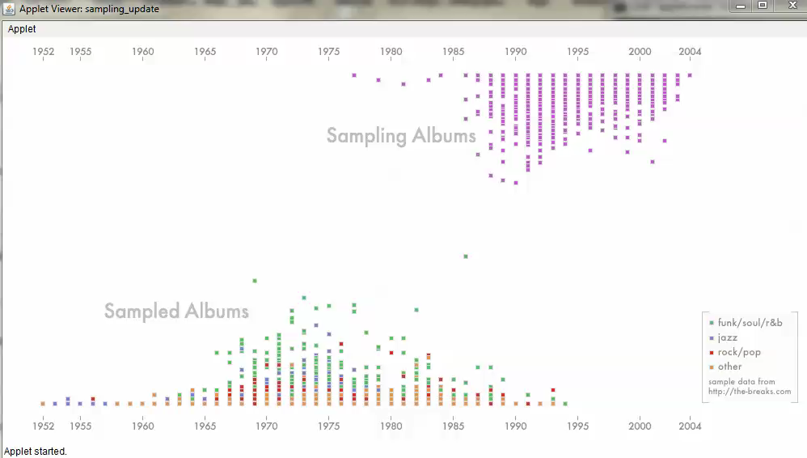
Case 6
http://jklabs.net/projects/samplinghistory/

Slide 69
Case 7
Abstract task:
Find repeating patterns (seasonality) in time series datasets
Isolate the periodicity
Compare aligned time series

Slide 70
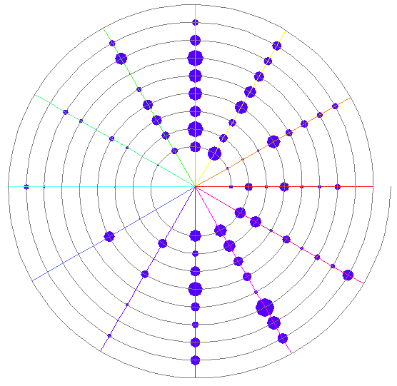
Spiral visualizations
Carlis et al., 1998
Figure 2. An indented spiral, with spokes, showing monthly
consumption percentages for Baphia Capparidifolia during the
period 1980 – 1988.

Slide 71
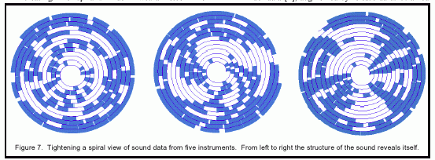
Spiral visualizations
Carlis et al., 1998

Slide 72
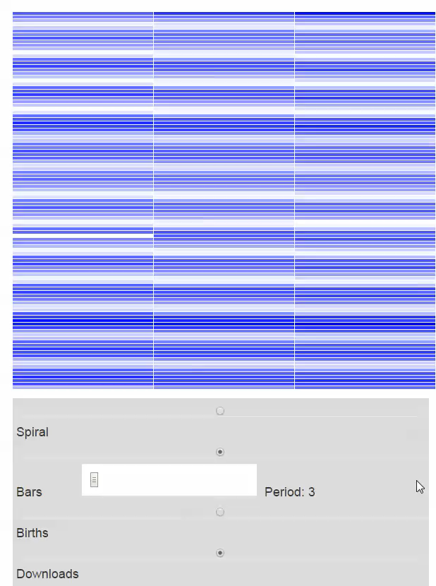
https://eagereyes.org/techniques/spirals

Slide 73
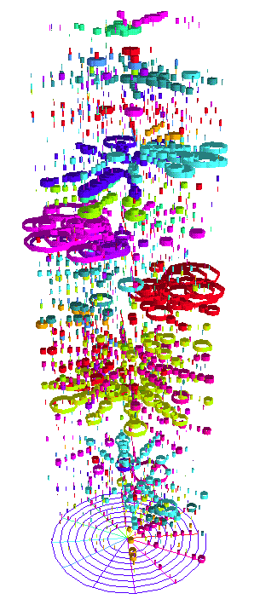
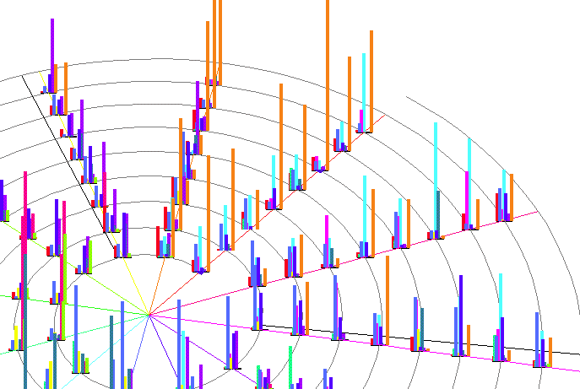
Notes:
112 foods

Slide 74
Case 8
Computer system management
Domain:
Very large temporal log data
More context of what is going on at the time
Abstract related info
Different levels of detail
Drill down for details

Slide 75
Case 8
Computer system management
Domain:
Very large temporal log data
More context of what is going on at the time
Abstract related info
Different levels of detail
Drill down for details
Abstract:
Problem tracking/identification
Correlations
Trends

Slide 76
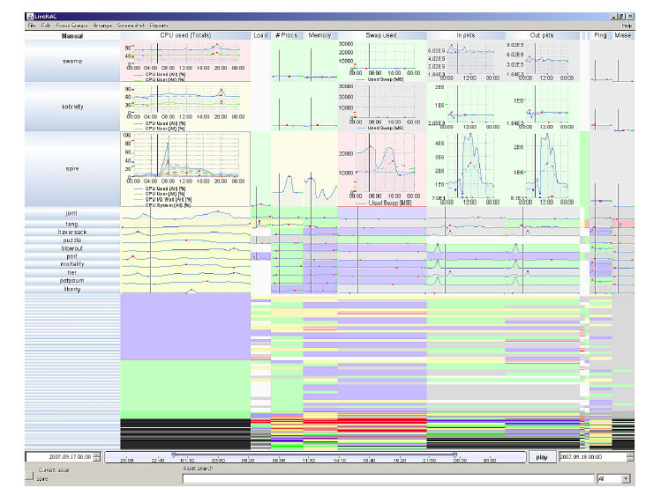
LiveRAC, McLachlan et al., 2008

Slide 77
Design Principles
Familiar visual representations when possible
Side-by-side comparisons of small multiples
Spatial position as visual cue
Explicit linking on multiple views
Shneiderman’s mantra
No abrupt visual changes
Immediate feedback

Slide 78
Summary
Identify the different domain goals
Isolate the tasks (there are many)
Select encodings that support the tasks
Standard types are a good place to start
Additional retinal variables often useful
Some less standard types might also be appropriate
Now for some Pandas…

